Slide 1
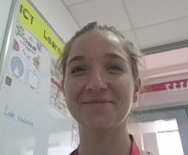
What can I share online?
By Ms Rhian

Slide 2
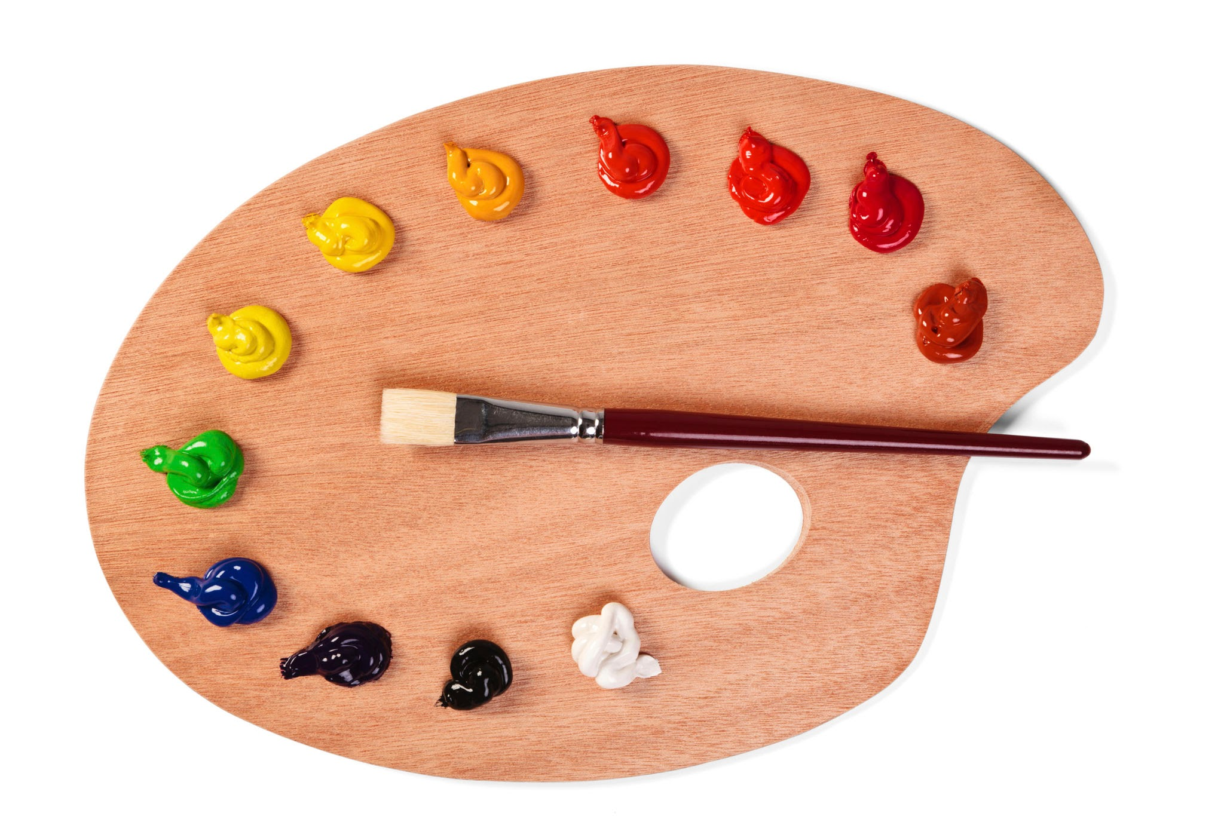
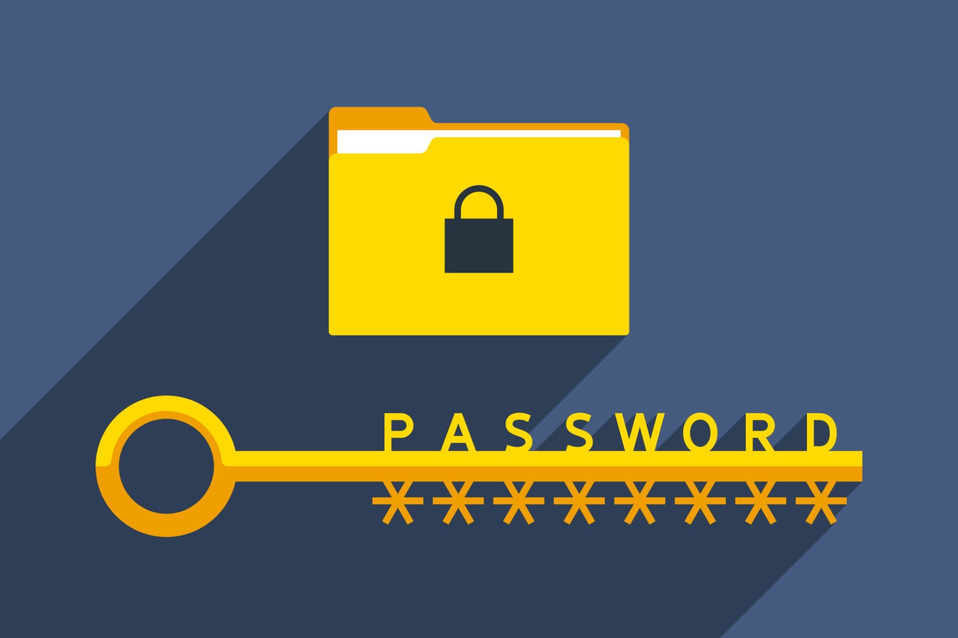


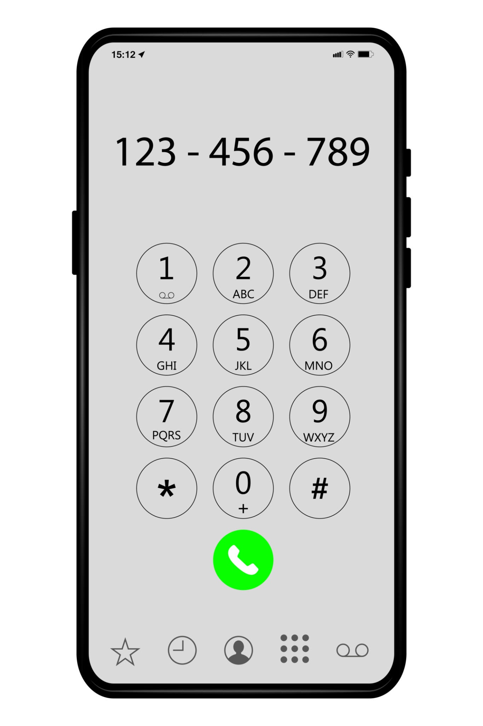




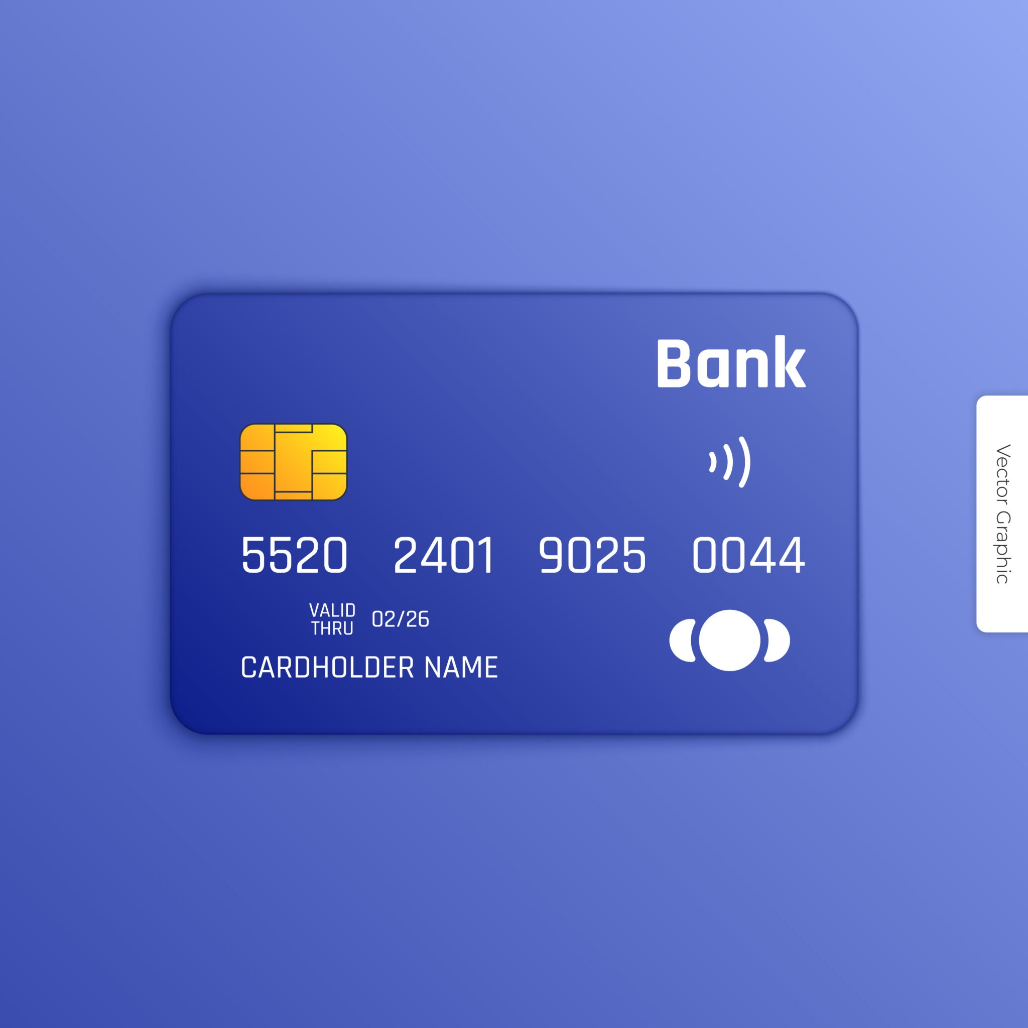

Private
Ok to share
Add 4 of your own images

Slide 3
What could happen if you share private information online?
If I shared my photo online,
If I share my school name online,
If I share my Google password online,

